Slide 1
Computer vision: models, learning and inference
Chapter 17
Models for shape
Notes:
ICP example video: http://www.youtube.com/watch?v=LlevpwUrWkE
ICP “fail”: http://www.youtube.com/watch?v=igb8mAJ6F5I
C:\users\brostow\ref\lectures\MachineVision_2010\in\ActiveShape_and_Appearance\siggraph99_BlanzVetter.mpg

Slide 2
Structure
Snakes
Template models
Statistical shape models
3D shape models
Models for shape and appearance
Non-linear models
Articulated models
Applications
Computer vision: models, learning and inference. ©2011 Simon J.D. Prince
2

Slide 3
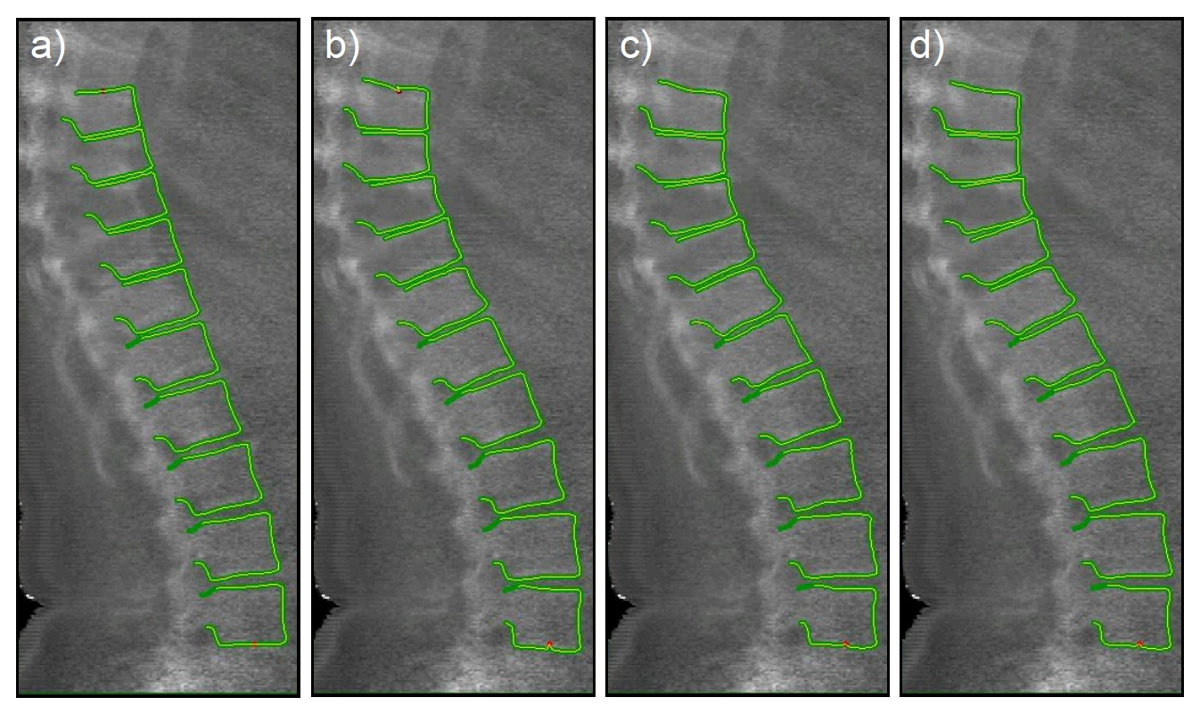
Motivation: fitting shape model
Computer vision: models, learning and inference. ©2011 Simon J.D. Prince
3

Slide 4

What is shape?
Kendall (1984) – Shape “is all the geometrical information that remains when location scale and rotational effects are filtered out from an object”
In other words, it is whatever is invariant to a similarity transformation (in this case)
Computer vision: models, learning and inference. ©2011 Simon J.D. Prince
4

Slide 5
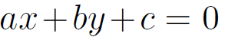
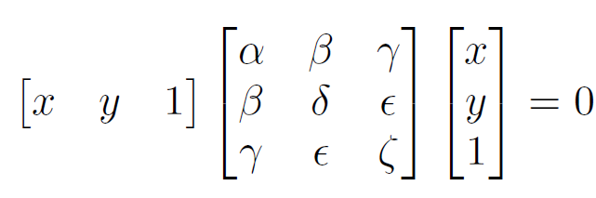
Representing Shape
Algebraic modeling
Line:
Conic:
More complex objects? Not practical for spine.
Computer vision: models, learning and inference. ©2011 Simon J.D. Prince
5

Slide 6
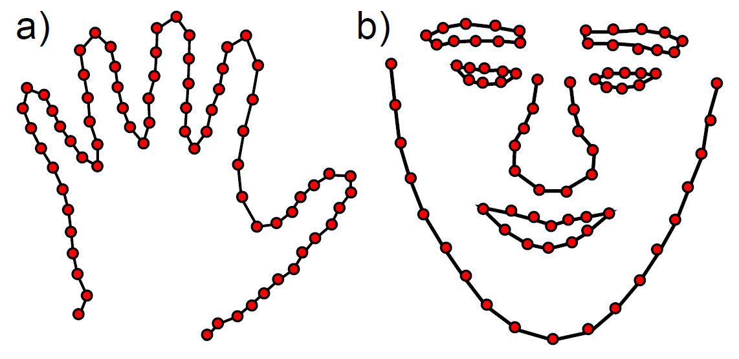
Landmark Points
Landmark points can be thought of as discrete samples from underlying contour
Ordered (single continuous contour)
Ordered with wrapping (closed contour)
More complex organisation (collection of closed and open)
Computer vision: models, learning and inference. ©2011 Simon J.D. Prince
6

Slide 7
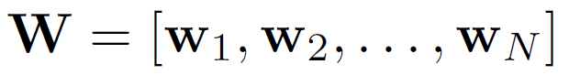
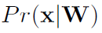
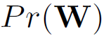
Snakes
Provide only weak information: contour is smooth
Represent contour as N 2D landmark points
We will construct terms for
The likelihood of observing an image x given landmark points W. Encourages landmark points to lie on border in the image
The prior of the landmark point. Encourages the contours to be smooth.
Computer vision: models, learning and inference. ©2011 Simon J.D. Prince
7

Slide 8
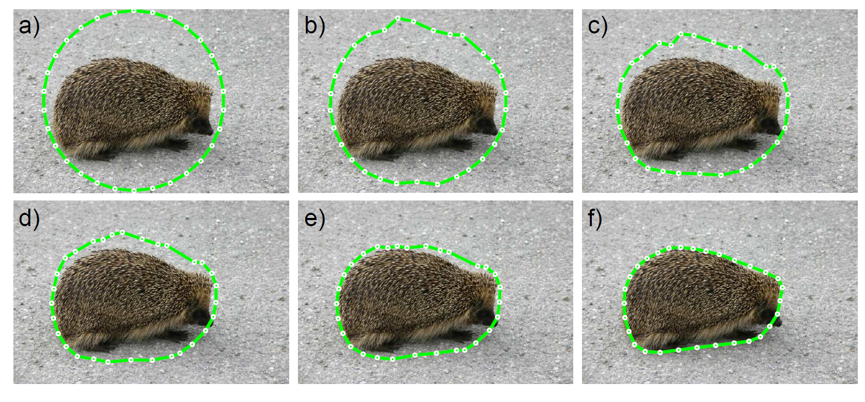
Snakes
Initialise contour and let it evolve until it grabs onto an object
Crawls across the image – hence called snake or active contour
Computer vision: models, learning and inference. ©2011 Simon J.D. Prince
8

Slide 9
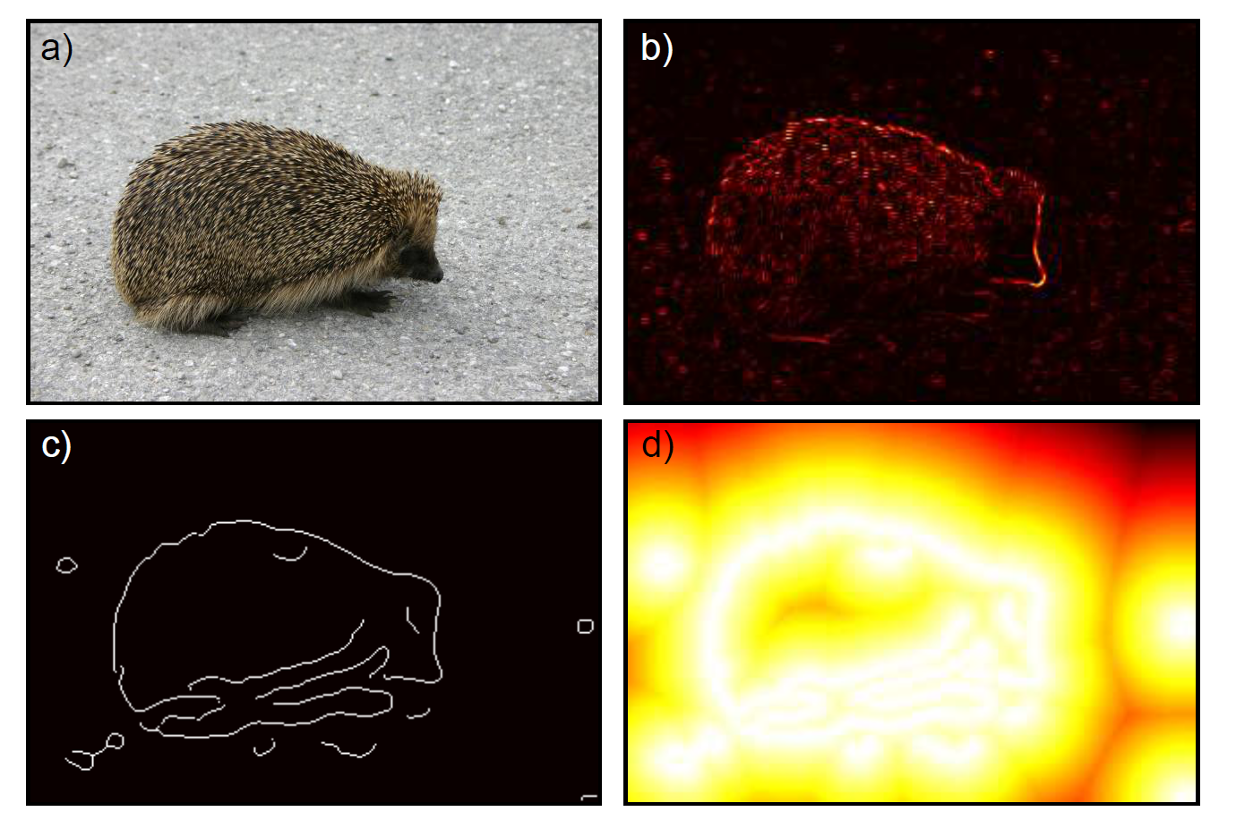
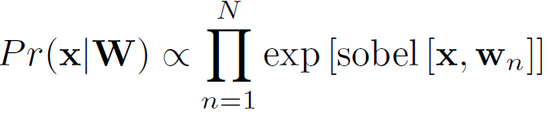
Snake likelihood
Has correct properties (probability high at edges), but flat in regions distant from the contour. Not good for optimisation.
Computer vision: models, learning and inference. ©2011 Simon J.D. Prince
9

Slide 10
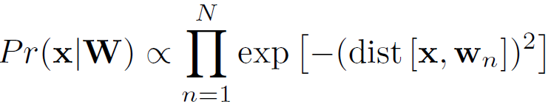
Snake likelihood (2)
Compute edges (here using Canny) and then compute distance image – this varies smoothly with distance from the image
Computer vision: models, learning and inference. ©2011 Simon J.D. Prince
10

Slide 11
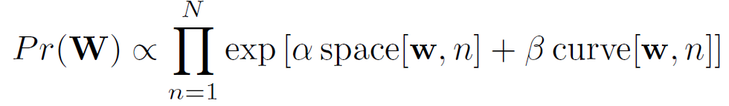
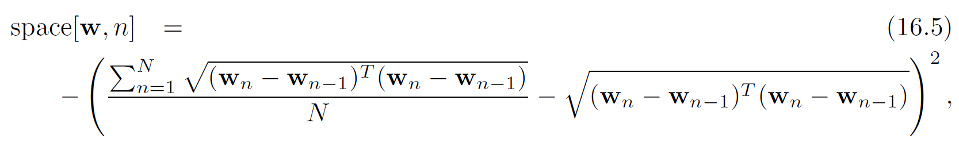
Prior
Encourages smoothness
Encourages equal spacing
Encourages low curvature
Computer vision: models, learning and inference. ©2011 Simon J.D. Prince
11

Slide 12
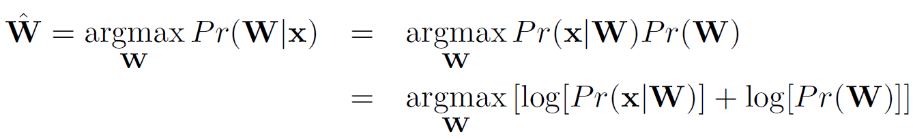
Inference
Maximise posterior probability
No closed form solution
Must use non-linear optimisation method
Number of unknowns = 2N
Computer vision: models, learning and inference. ©2011 Simon J.D. Prince
12

Slide 13

Snakes
Notice failure at nose – falls between points.
A better model would sample image between landmark points
Computer vision: models, learning and inference. ©2011 Simon J.D. Prince
13

Slide 14
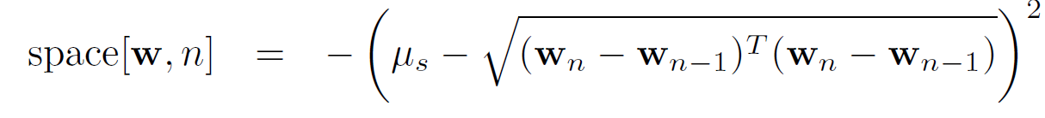
Inference
Maximise posterior probability
Very slow. Can potentially speed it up by changing spacing element of prior:
Take advantage of limited connectivity of associated graphical model
Computer vision: models, learning and inference. ©2011 Simon J.D. Prince
14

Slide 15
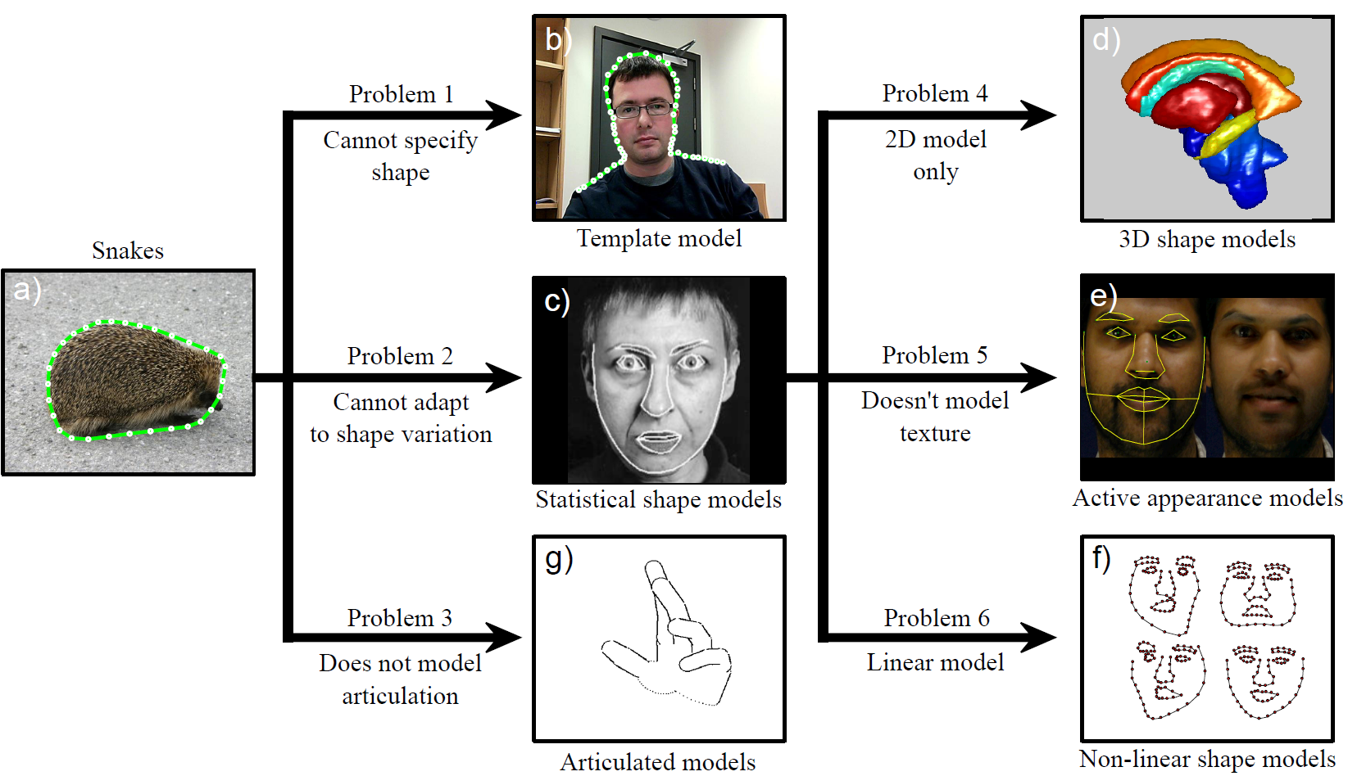
Relationships between models
Computer vision: models, learning and inference. ©2011 Simon J.D. Prince
15

Slide 16
Structure
Snakes
Template models
Statistical shape models
3D shape models
Models for shape and appearance
Non-linear models
Articulated models
Applications
Computer vision: models, learning and inference. ©2011 Simon J.D. Prince
16

Slide 17
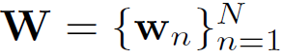
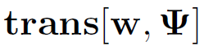
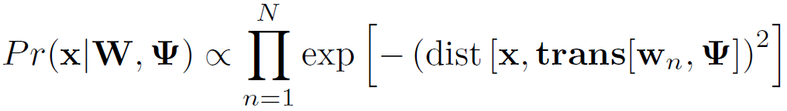
Shape template model
Shape based on landmark points
These points are assumed known
Mapped into the image by transformation
What is left is to find parameters of transformation
Likelihood is based on distance transform:
No prior on parameters (but could have one)
Computer vision: models, learning and inference. ©2011 Simon J.D. Prince
17

Slide 18
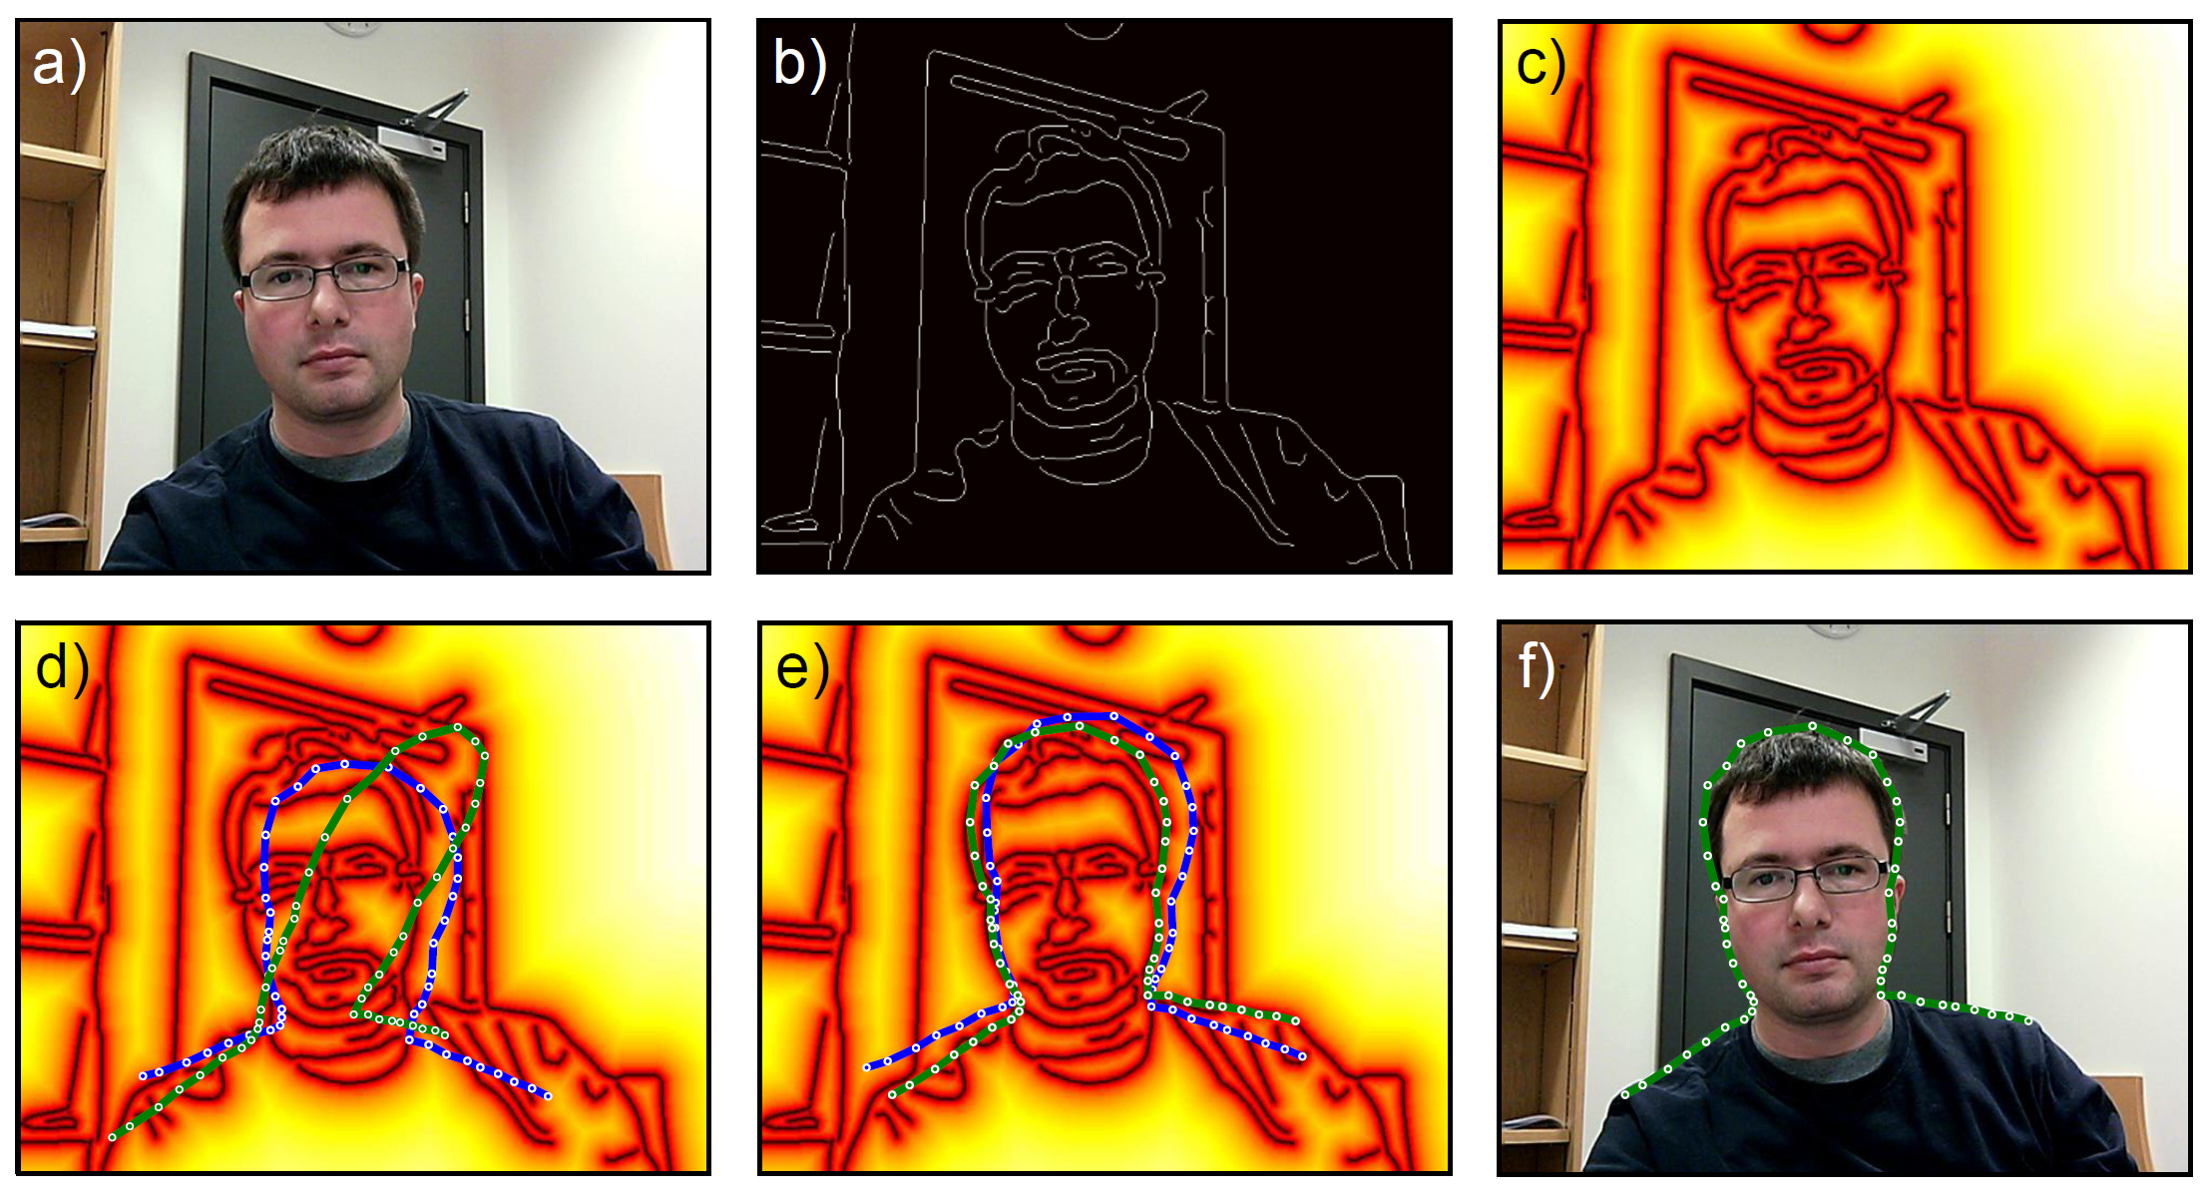
Shape template model
Computer vision: models, learning and inference. ©2011 Simon J.D. Prince
18

Slide 19
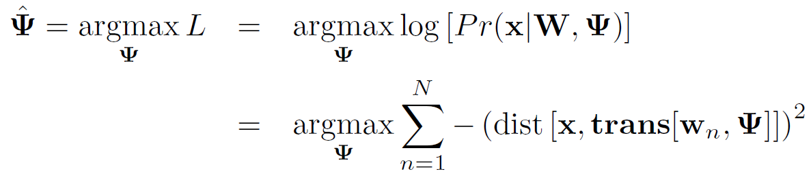
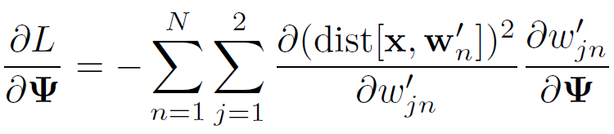
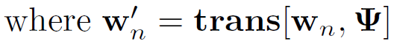
Inference
Use maximum likelihood approach
No closed form solution
Must use non-linear optimization
Use chain rule to compute derivatives
Computer vision: models, learning and inference. ©2011 Simon J.D. Prince
19

Slide 20
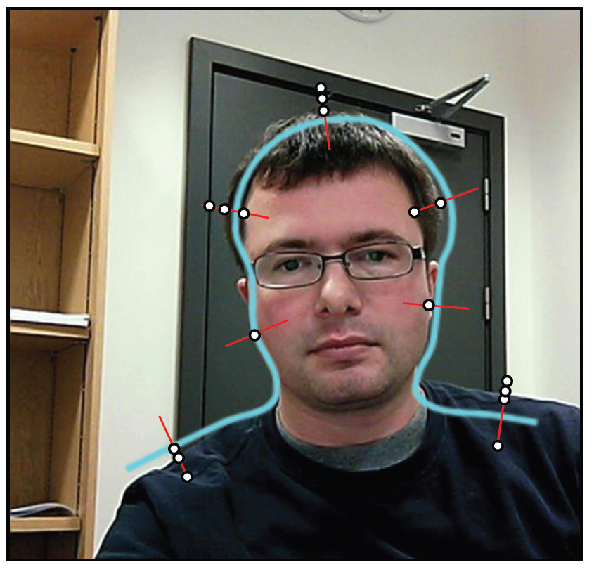
Alternative: Iterative closest points
Find nearest edge point to each landmark point
Compute transformation in closed form
Repeat
Computer vision: models, learning and inference. ©2011 Simon J.D. Prince
20

Slide 21
Structure
Snakes
Template models
Statistical shape models
3D shape models
Models for shape and appearance
Non-linear models
Articulated models
Applications
Computer vision: models, learning and inference. ©2011 Simon J.D. Prince
21

Slide 22
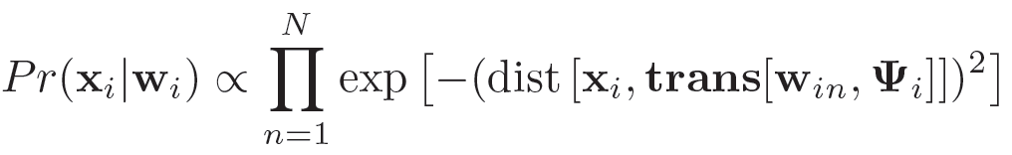
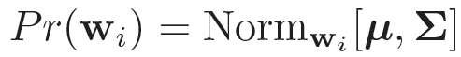
Statistical shape models
Also called
Point distribution models
Active shape models (as they adapt to the image)
Likelihood:
Prior:
Computer vision: models, learning and inference. ©2011 Simon J.D. Prince
22

Slide 23
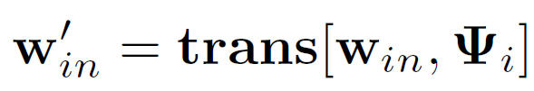
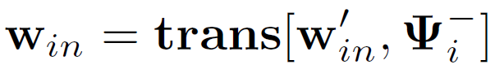
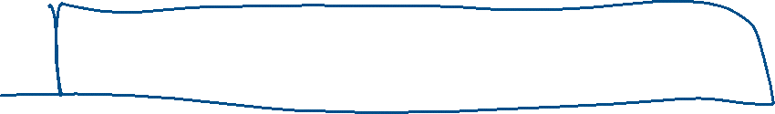
Learning
Usually, we are given the examples after they have been transformed
Before we can learn the normal distribution, we must compute the inverse transformation
Procedure is called generalized Procrustes analysis
Computer vision: models, learning and inference. ©2011 Simon J.D. Prince
23

Slide 24
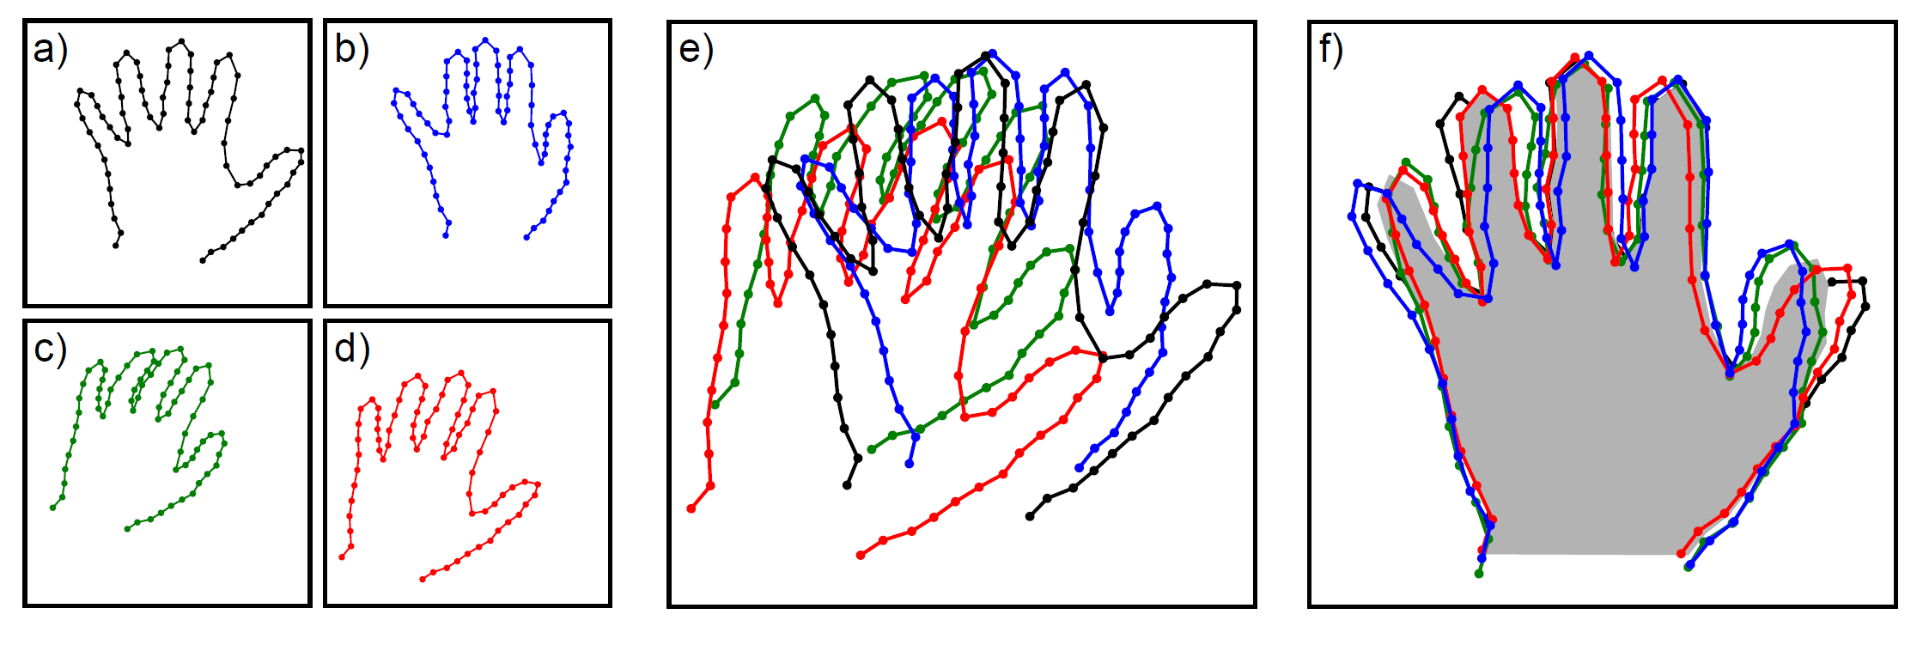

Generalized Procrustes analysis
Training data
Before alignment
After alignment
Computer vision: models, learning and inference. ©2011 Simon J.D. Prince
24

Slide 25
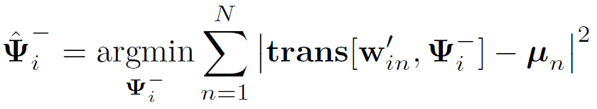
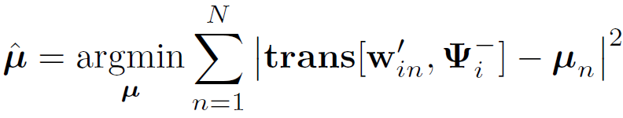



Generalized Procrustes analysis
Alternately
Update all transformations to map landmark points to current mean
Update mean to be average of transformed values,
Then learn mean and variance parameters.
Computer vision: models, learning and inference. ©2011 Simon J.D. Prince
25

Slide 26
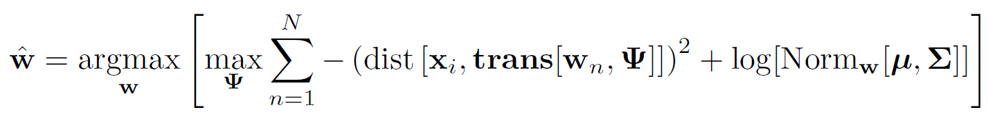

Inference
Map inference:
No closed form solution
Use non-linear optimisation
Or use ICP approach
However, many parameters, and not clear they are all needed
more efficient to use subspace model
Computer vision: models, learning and inference. ©2011 Simon J.D. Prince
26

Slide 27
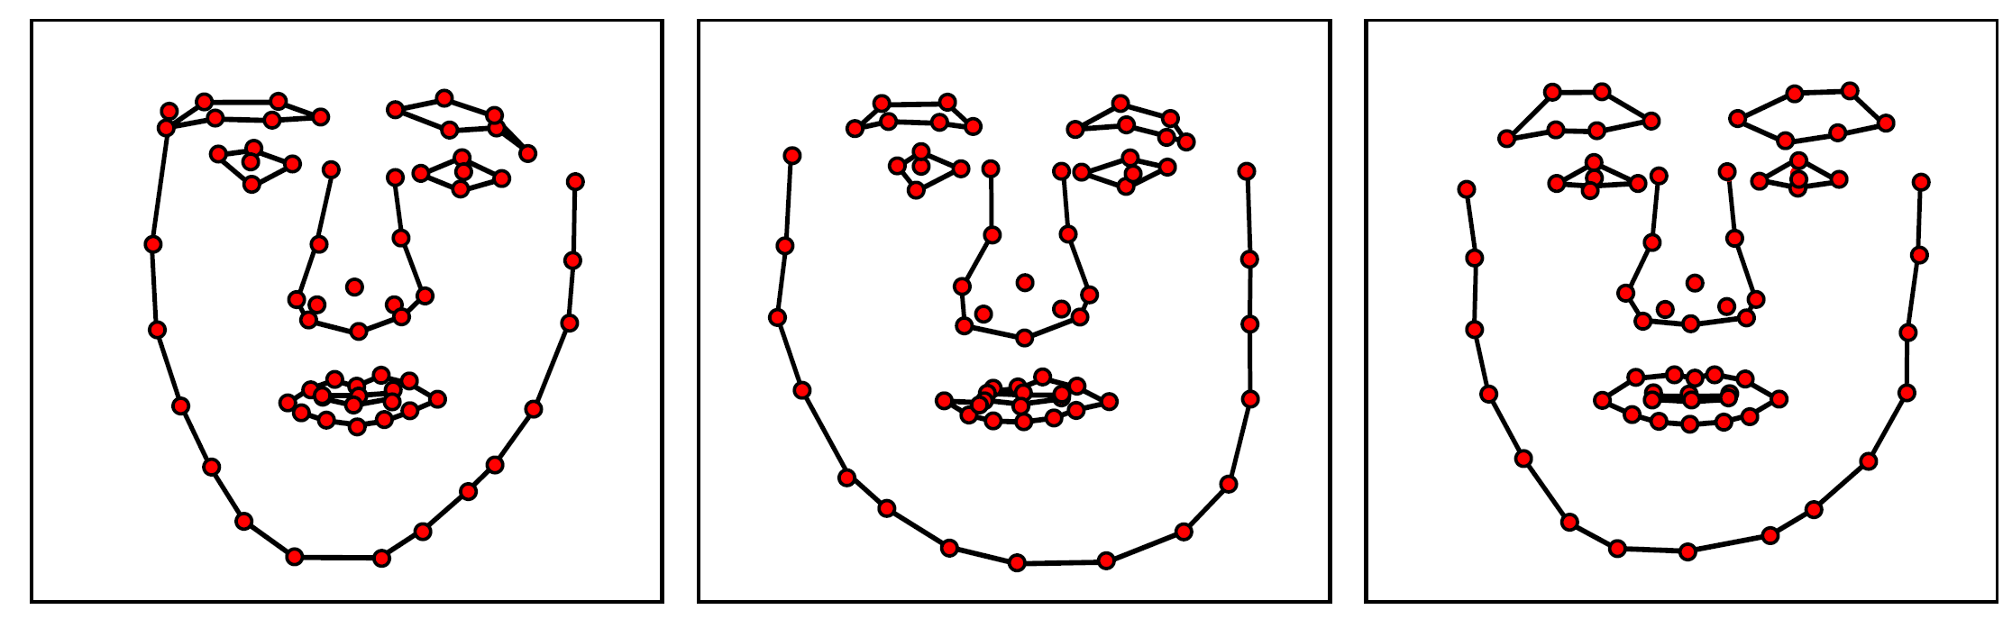
Face model
Three samples from learned model for faces
Computer vision: models, learning and inference. ©2011 Simon J.D. Prince
27

Slide 28
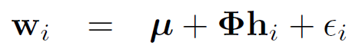
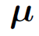
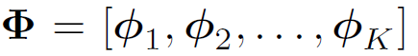
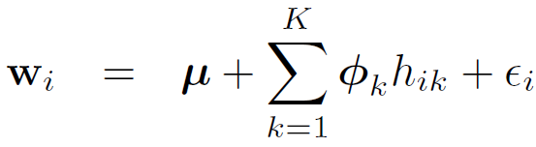
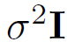
Subspace shape model
Generate data from model:
is the mean shape
the matrix contains K basis functions in it columns
is normal noise with covariance
Can alternatively write
Computer vision: models, learning and inference. ©2011 Simon J.D. Prince
28

Slide 29
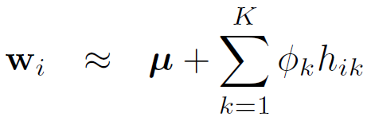
Approximating with subspace
Subspace model
Can approximate a vector w with a weighted sum of the basis functions
Surprising how well this works even with a small number of basis functions
Computer vision: models, learning and inference. ©2011 Simon J.D. Prince
29

Slide 30
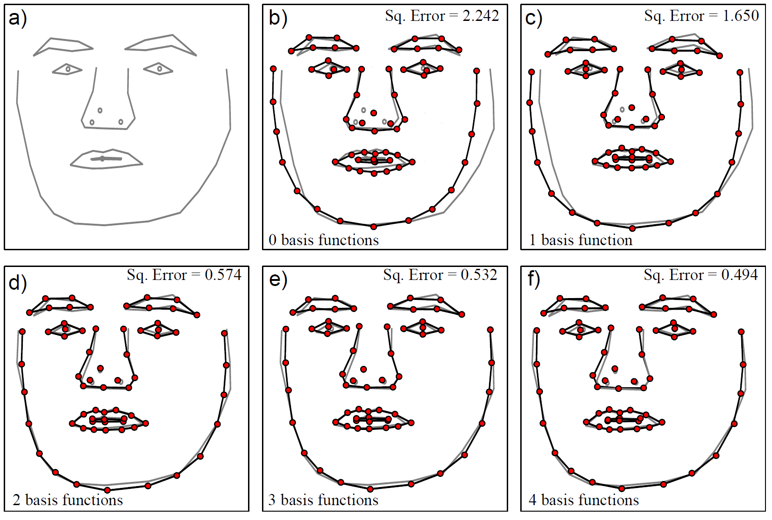
Subspace shape model
Computer vision: models, learning and inference. ©2011 Simon J.D. Prince
30

Slide 31
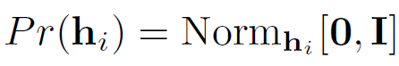
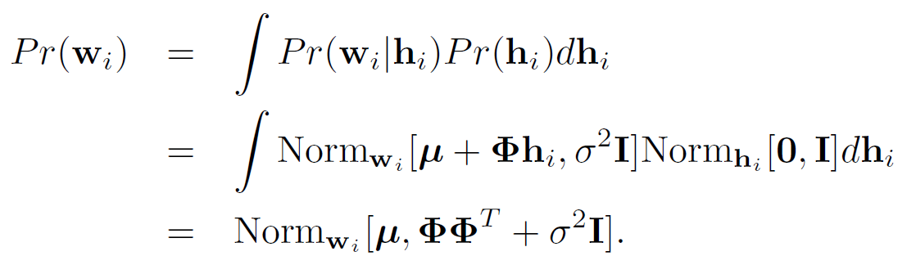
Probabilistic PCA
Generative eq:
Probabilistic version:
Add prior:
Density:
Computer vision: models, learning and inference. ©2011 Simon J.D. Prince
31

Slide 32
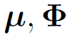
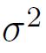
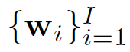
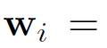
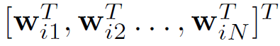
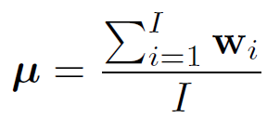
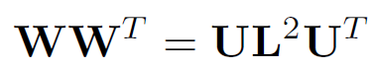

Learning PPCA
Learn parameters and from data ,
where .
Learn mean:
Then set and compute eigen-decomposition
Choose parameters
Computer vision: models, learning and inference. ©2011 Simon J.D. Prince
32

Slide 33

Properties of basis functions
Learning of parameters based on eigen-decomposition:
Parameters
Notice that:
Basis functions in are orthogonal
Basis functions in are ordered
Computer vision: models, learning and inference. ©2011 Simon J.D. Prince
33

Slide 34

Learned hand model
Computer vision: models, learning and inference. ©2011 Simon J.D. Prince
34

Slide 35

Learned spine model
Mean
Manipulating first principal component
Manipulating second principal component
Computer vision: models, learning and inference. ©2011 Simon J.D. Prince
35

Slide 36
Inference
To fit model to an image:
likelihood
prior
ICP Approach:
Find closest points to current prediction
Update weightings h
Find closest points to current prediction
Update transformation parameters ψ
Computer vision: models, learning and inference. ©2011 Simon J.D. Prince
36

Slide 37


Inference
1. Update weightings h
If transformation parameters can be represented as a matrix A
2. Update transformation parameters ψ
Using one of the closed form solutions
Computer vision: models, learning and inference. ©2011 Simon J.D. Prince
37

Slide 38

Fitting model
Much better to use statistical classifier instead of just distance from edges
Computer vision: models, learning and inference. ©2011 Simon J.D. Prince
38

Slide 39
Structure
Snakes
Template models
Statistical shape models
3D shape models
Models for shape and appearance
Non-linear models
Articulated models
Applications
Computer vision: models, learning and inference. ©2011 Simon J.D. Prince
39

Slide 40


3D shape models
Computer vision: models, learning and inference. ©2011 Simon J.D. Prince
40

Slide 41
Structure
Snakes
Template models
Statistical shape models
3D shape models
Models for shape and appearance
Non-linear models
Articulated models
Applications
Computer vision: models, learning and inference. ©2011 Simon J.D. Prince
41

Slide 42

Statistical models for shape and appearance
Computer vision: models, learning and inference. ©2011 Simon J.D. Prince
42

Slide 43

Statistical models for shape and appearance
1. We draw a hidden variable h from a prior
Computer vision: models, learning and inference. ©2011 Simon J.D. Prince
43

Slide 44
Statistical models for shape and appearance
We draw a hidden variable h from a prior
We draw landmark points w from a subspace model
We draw image intensities x.
Generate image intensities in standard template shape
Transform the landmark points (parameters ψ)
Transform the image to landmark points
Add noise
Computer vision: models, learning and inference. ©2011 Simon J.D. Prince
44

Slide 45

Shape and appearance model
Shape model
Intensity model
Shape and intensity
Computer vision: models, learning and inference. ©2011 Simon J.D. Prince
45

Slide 46

Warping images
Piecewise affine transformation
Triangulate image points using Delaunay triangulation.
Image in each triangle is warped by an affine transformation.
Computer vision: models, learning and inference. ©2011 Simon J.D. Prince
46

Slide 47

Learning
Goal is to learn parameters :
Problem
We are given the transformed landmark points
We are given the warped and transformed images
Solution
Use Procrustes analysis to un-transform landmark points
Warp observed images to template shape
Computer vision: models, learning and inference. ©2011 Simon J.D. Prince
47

Slide 48



Learning
Now have aligned landmark points w, and aligned images x, we can learn the simpler model:
Can write generative equation as:
Has the form of a factor analyzer
Computer vision: models, learning and inference. ©2011 Simon J.D. Prince
48

Slide 49


Inference
Likelihood of observed intensities
To fit the model use maximum likelihood
This has the least squares form
Computer vision: models, learning and inference. ©2011 Simon J.D. Prince
49

Slide 50


Inference
This has the least squares form
Use Gauss-Newton method or similar
Where the Jacobian J is a matrix with elements
Computer vision: models, learning and inference. ©2011 Simon J.D. Prince
50

Slide 51
Statistical models for shape and appearance
Computer vision: models, learning and inference. ©2011 Simon J.D. Prince
51

Slide 52
Structure
Snakes
Template models
Statistical shape models
3D shape models
Models for shape and appearance
Non-linear models
Articulated models
Applications
Computer vision: models, learning and inference. ©2011 Simon J.D. Prince
52

Slide 53
Non-linear models
The shape and appearance models that we have studied so far are based on the normal distribution
But more complex shapes might need more complex distributions
Could use mixture of PPCAs or similar
Or use a non-linear subspace model
We will investigate the Gaussian process latent variable model (GPLVM)
To understand the GPLVM, first think about PPCA in terms of regression.
Computer vision: models, learning and inference. ©2011 Simon J.D. Prince
53

Slide 54

PPCA as regression
PPCA model:
First term in last equation looks like regression
Predicts w for a given h
Considering each dimension separately, get linear regression
Computer vision: models, learning and inference. ©2011 Simon J.D. Prince
54

Slide 55

PPCA as regression
Joint probability distribution
Regress 1st dimension against hidden variable
Regress 2nd dimension against hidden variable
Computer vision: models, learning and inference. ©2011 Simon J.D. Prince
55

Slide 56
Gaussian process latent variable model
Idea: replace the linear regression model with a non-linear regression model
As name suggests, use Gaussian process regression
Implications
Can now marginalize over parameters μ and Φ
Can no longer marginalize over variable h
Computer vision: models, learning and inference. ©2011 Simon J.D. Prince
56

Slide 57

GPLVM as regression
Joint probability distribution
Regress 1st dimension against hidden variable
Regress 2nd dimension against hidden variable
Computer vision: models, learning and inference. ©2011 Simon J.D. Prince
57

Slide 58

Learning
In learning the Gaussian process regression model , we optimized the marginal likelihood of the data with respect to the parameter σ².
Computer vision: models, learning and inference. ©2011 Simon J.D. Prince
58

Slide 59

Learning
In learning the GPLVM, we still optimized the marginal likelihood of the data with respect to the parameter σ², but must also find the values of the hidden variables that we regress against .
Use non-linear optimization technique
Computer vision: models, learning and inference. ©2011 Simon J.D. Prince
59

Slide 60


Inference
To predict a new value of the data using a hidden variable
To compute density
Cannot be computed in closed from
Computer vision: models, learning and inference. ©2011 Simon J.D. Prince
60

Slide 61

GPLVM Shape models
Computer vision: models, learning and inference. ©2011 Simon J.D. Prince
61

Slide 62
Structure
Snakes
Template models
Statistical shape models
3D shape models
Models for shape and appearance
Non-linear models
Articulated models
Applications
Computer vision: models, learning and inference. ©2011 Simon J.D. Prince
62

Slide 63
Articulated Models
Transformations of parts applied one after each other
Known as a kinematic chain
e.g. Foot transform is relative to lower leg, which is relative to upper leg etc.
One root transformation that describes the position of model relative to camera
Computer vision: models, learning and inference. ©2011 Simon J.D. Prince
63

Slide 64

Articulated Models
Computer vision: models, learning and inference. ©2011 Simon J.D. Prince
64

Slide 65

Articulated Models
One possible model for an object part is a quadric
Represents spheres, ellipsoids, cylinders, pairs of planes and others
Make truncated cylinders by clipping with cylinder with pair of planes
Projects to conic in the image
Computer vision: models, learning and inference. ©2011 Simon J.D. Prince
65

Slide 66
Structure
Snakes
Template models
Statistical shape models
3D shape models
Models for shape and appearance
Non-linear models
Articulated models
Applications
Computer vision: models, learning and inference. ©2011 Simon J.D. Prince
66

Slide 67

3D morphable models
Computer vision: models, learning and inference. ©2011 Simon J.D. Prince
67

Slide 68

3D morphable models
Computer vision: models, learning and inference. ©2011 Simon J.D. Prince
68

Slide 69

3D morphable models
Computer vision: models, learning and inference. ©2011 Simon J.D. Prince
69

Slide 70

3D body model
Computer vision: models, learning and inference. ©2011 Simon J.D. Prince
70

Slide 71

3D body model applications
Computer vision: models, learning and inference. ©2011 Simon J.D. Prince
71

Slide 72
Conclusions
Introduced a series of models for shape
Assume different forms of prior knowledge
Contour is smooth (snakes)
Shape is known, but not position (template)
Shape class is known (statistical models)
Structure of shape known (articulated model)
Relates to other models
Based on subspace models
Tracked using temporal models
Computer vision: models, learning and inference. ©2011 Simon J.D. Prince
72

